Slide 1
Netflix vs. Hulu: Analyzing Streaming Service Content
Ayesha Abdulahi - B.S. Computational and Data Science, B.S. Criminology, Law and Society, Minor in Data Analysis

Slide 2
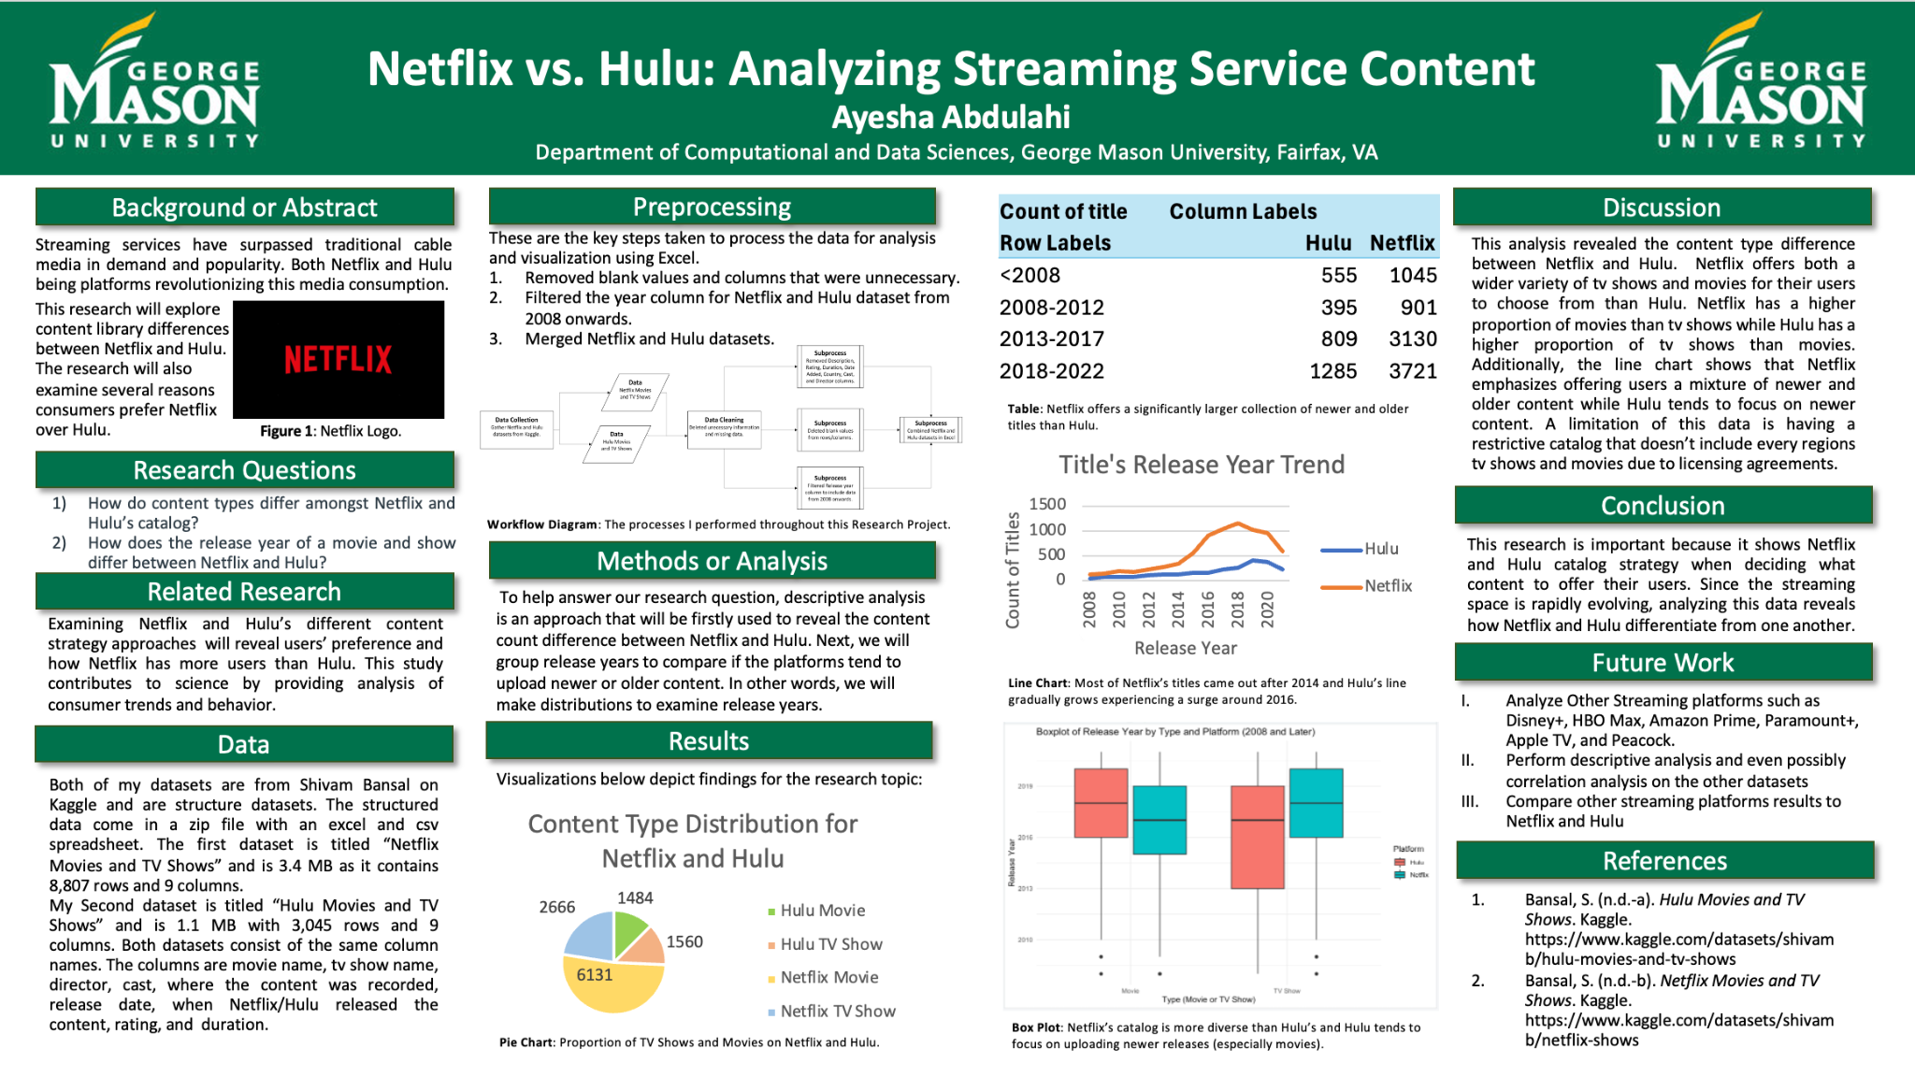

Slide 3
Why this topic?
Streaming services have overtaken traditional cable media in popularity with Netflix and Hulu being platforms that have revolutionized the streaming space. Since Netflix and Hulu launched their streaming services months apart, indicators such as content library differences can be used to decipher the reasoning Netflix has more users than Hulu; as well as how Netflix has differentiated itself from Hulu.

Slide 4
Related Research
Examining Netflix and Hulu’s content libraries will help identify their content strategy approaches. This study contributes to science by providing analysis of consumer trends and behavior.
Research Questions
RQ1: | How do content types differ amongst Netflix and Hulu’s catalog?
RQ2: | How does the release year of a movie and show differ between Netflix and Hulu?

Slide 5
Table of contents
01
03
02
Data
Conclusion
Slides 6-8: Datasets and the processing of these datasets.
Slides 14-15: Why this research is important and closing remarks.
Visualizations
Slides 9-13: Data visualizations used to communicate findings.

Slide 6
1
Data
What datasets were used? How were the datasets cleaned, sorted, and analyzed?

Slide 7



Data Processing
Both of my datasets are from Kaggle and are structured datasets that came in a zip file with an excel and csv spreadsheet. The first dataset is titled “Netflix Movies and TV Shows” and it contains 8,807 rows and 9 columns. My second dataset is titled “Hulu Movies and TV Shows” and has 3,045 rows and 9 columns. Both datasets consist of the same column names. The column titles are movie name, tv show name, director, cast, where the content was recorded, release date, when Netflix/Hulu released the content, rating, and duration.
Softwares such as Excel were used to clean, sort, and analyze the data. Additionally, R-Studio was also used to analyze the data.
Data processing workflow diagram made in Microsoft Visio.

Slide 8
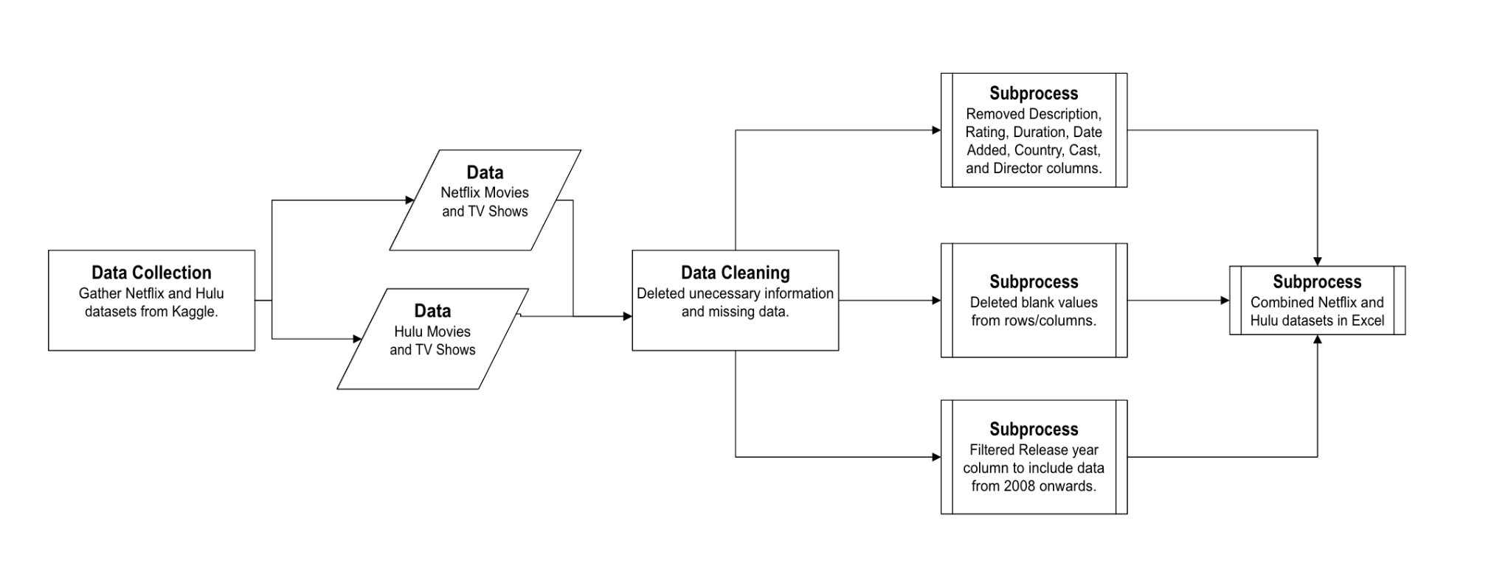
Data Processing
Workflow diagram of the processes performed on my datasets.

Slide 9
2
Visualizations
What charts, tables and plots were used?

Slide 10
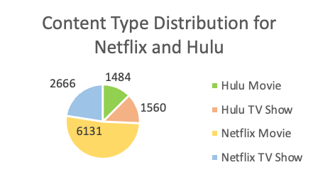
Pie Chart
The distribution shows the proportion of movies and tv shows Netflix and Hulu offer on their platforms.
Netflix offers 4,647 more movies and 1,106 more tv shows than Hulu. Additionally, Netflix has a higher proportion of movies than tv shows while Hulu has a higher proportion of tv shows than movies.

Slide 11
Table
The table shows throughout several time periods the proportion of tv shows and movies Netflix and Hulu offer their users.
Netflix has significantly more newer and older titles than Hulu.
Both Netflix and Hulu have the least amount of their titles from the time period 2008-2012 and prior to 2008.
Count of title | Column Labels
Row Labels | Hulu | Netflix
<2008 | 555 | 1045
2008-2012 | 395 | 901
2013-2017 | 809 | 3130
2018-2022 | 1285 | 3721

Slide 12
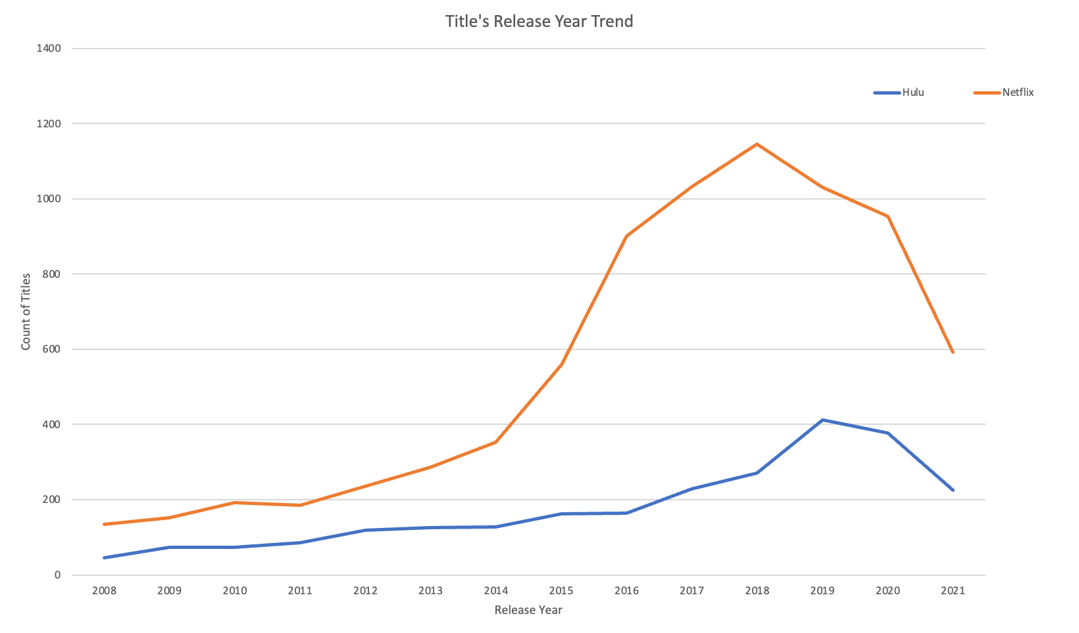
Line Chart
The line trend shows whether Netflix and Hulu prioritize newer or older content on their platforms.
Majority of the content on Netflix came out after 2014 with content released in 2018 being Netflix’s peak .
Hulu experienced gradual improvement as content released in 2019 being Hulu’s peak.

Slide 13
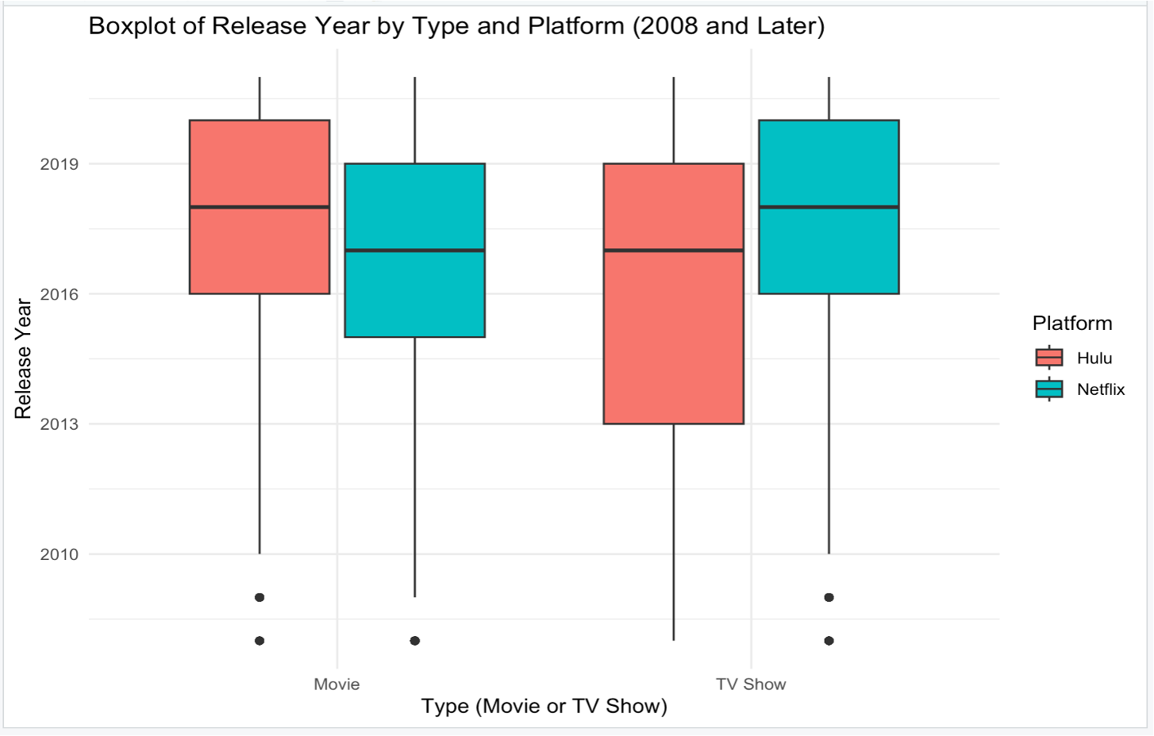
Boxplot
The distribution shows release year of tv shows and Movies by the streaming platform.
Hulu is focused on uploading more recent content, especially movies.
Netflix has a more diverse streaming catalog as it’s boxplot has a wider range than Hulu’s.

Slide 14
3
Conclusion
What does this research communicate?

Slide 15



Conclusion
The research shows that Netflix’s extensive catalog, offering a higher proportion of movies than tv shows, and providing users with a mixture of newer and older content are content strategy approaches Netflix used to differentiate itself from Hulu. For this reason, Netflix is a more desired streaming platform to have than Hulu.
vs.

